Slide 1
Trykaa: Transforming the Future of Online Fashion Retail
Revolutionizing the Apparel Industry with Try-At-Home Shopping
Prince
Founder at Trykaa Clothing Private Limited

Slide 2
Overview of Trykaa and its unique value proposition
Trykaa is an online hyperlocal multi brand platform of western and indian wears for fashion enthusiasts.
USP :
It’s just like offline mall shopping.
Customers try the clothes without paying for them upfront.
Trykaa fulfills the fundamental need of why customers shop offline.
Pay only when it fits you and looks great on you.

Slide 3
Challenges in online fashion retail
For Customers:
Customers hesitant to buy mid-range and high range value items online.
Shopping time extended to days and inconvenient cycles of placing orders and return requests in search of customer’s perfect look and fit.
For Business:
Returns:
Decrease in overall revenue due to delayed restocking of returned items.
High operational costs incurred for facilitating return requests of the customers.

Slide 4
Solution - Trykaa's Unique Model
Trykaa's business model allows users to try clothes at home without upfront payment.
Hyperlocal model - region based catalogs for customers
Customers can order in bulk without payment and try at home
2 hours to try, purchase and return items
No return cost for brands/suppliers
Products once bought after home trials cannot be returned.
Reduces the risk for customers and improves their shopping experience.
Try variety of styles and designs in bulk at home without payment
More confidence while shopping for multiple/expensive clothes online
Be done with your shopping and returns within hours.

Slide 5
Market Opportunity
- Size and growth potential of the online fashion retail market.
Online retail is far behind offline retail in terms of market share and ticket size per purchase order.
It use because of what offline stores offer. Touch, feel and trial rooms before purchase.
- Trykaa taps into this vast market with its innovative approach.
Trykaa fulfills the fundamental need of why customers shop offline.
“Try Before You Buy” provides more confident and risk-free shopping experience to the customers.
With successful execution, Trykaa can fulfill the primary needs of a customers to visit offline store.

Slide 6
Who are our customers?
Initial Phase:
Corporate employees in urban, high-density areas (like Gurgaon) with high Buying Power and Fashion Consciousness
In the long run
Urban Professionals and Young Adults
Overall, Trykaa’s flexibility, focus on convenience, and try-at-home model align with the needs of time-conscious, fashion-oriented customers in urban areas, making them the ideal target both in the initial phase and as the business scales.

Slide 7
Very small scale, proof of concept conducted last year
Trykaa selling apparels to female customers in NCR only through website.
Social Media Marketing used to reach out to customers.
All Orders were delivered by Prince only, not charging any delivery fees.
Payment either in cash or UPI at customer location.
Outcome
Total Order Received - 40+
Total Order FulFilled - 13
Avg Sale - Rs 2177(8 customers)
Repeat Customers - 2
Orders delivered in Delhi, Noida, Faridabad
No theft or orders related risk encountered.
Most customers took around 45 mins-1 hr to try and finalise the last purchase order.

Slide 8
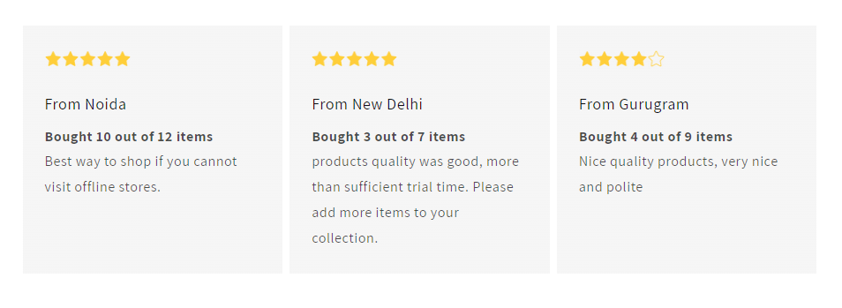
Customer Purchase Behaviour and Reviews

Slide 9
Why Apparel Brands Should Partner with Trykaa
Increase in sales of mid-range and high value items along with items in affordable range
Build Trust:
Trykaa can help brands build trust much faster. No-risk while shopping leads to higher customer satisfaction
Data-Driven Insights: Trykaa collects valuable data on customer preferences and behavior, which can be shared with partner brands.
Marketing and Exposure: In coming future, Trykaa will actively promote partner brands to its user base via co-branding and collaborative marketing efforts.
Risk Free i.e. loss due to damage etc., is borne by us.

Slide 10
Competitors
Traditional E-commerce Platforms
Examples: Myntra, Amazon Fashion, Flipkart Fashion
Brick-and-Mortar Stores with In-Store Pickup & Return Policies
Examples: Shoppers Stop, Trends
Waise, any player that eats into our potential revenue by fulfilling similar customer needs is a competitor!
However, Trykaa’s main differentiation lies in offering a hybrid try-at-home service for high-quality, mid-to-high-range fashion without upfront full payment.

Slide 11
Why invest in Trykaa?
Back a scalable, forward-thinking solution that modernizes the fashion retail experience in India and potentially beyond.
First-Mover Advantage in a Niche Market
Scalability and Expansion Potential
Attractive Return on Investment (ROI)
Equity Growth in an Emerging Business
Exit Opportunities
Revenue Diversification Opportunities
Service Fees and Add-Ons
Data licensing & Brand Partnerships

Slide 12
What we need?
Capital Investment
Inventory & Warehousing
Logistics
Technology
Strategic Guidance
Scaling & Operations Expertise
Growth Marketing
Industry Connections
Investors/Partners who understand the apparel market's current shifts—like rising customer demands for convenience, quality, and a tactile shopping experience—may identify the potential for Trykaa to transform online shopping habits, filling a gap in the market that is poised for growth. With the right support, we can build a trusted, scalable service that revolutionizes the online shopping experience in India.

Slide 13
Conclusion
Unique Offering:
Trykaa provides customers with an in-home trial experience for premium apparel, combining the ease of online shopping with the assurance of in-person fitting.
Customer Appeal:
By reducing purchase hesitations, we target an untapped market segment, especially within corporate circles where convenience is paramount.
Risk Mitigation:
With identity verification and a partial upfront payment model, Trykaa addresses potential operational risks effectively.
Scalability:
With an initial focus on Gurgaon, we plan to expand as we refine our processes, opening possibilities across major cities

Slide 14
Contact Information
Prince, Founder at Trykaa
Phone - +91 9565521581
Email - prince@trykaa.com
Alternate Email - prince.mst13@itbhu.ac.in

